Slide 1





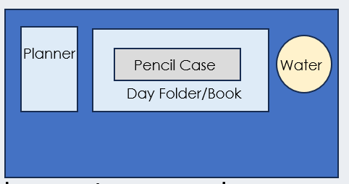

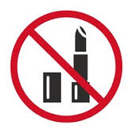

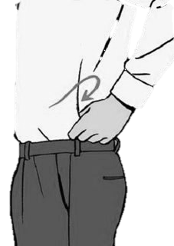


After the register, I am checking your….
Desk
Uniform
SLANT
All subject books go into your bag
(not floor or shelf!)
Notes:
This is you setting your expectation – issue demerits for uniform/equipment if they do not meet your expectation after this.

Slide 2







Read Now
Wednesday, 28 January 2026
Conservation of Mass
Task:
Complete the Read Now by:
Stick in the sheet.
Using a highlighter as you read to identify key terms.
Answer the first four recall questions under the sheet in your book.
Answer the stretch question
Aim High | Work Together | Be Kind | Lead the Way

Slide 3

Read Now
Answers:
c. It stays the same
False
Rearranged
Because the same atoms are present before and after the reaction, they are just rearranged, not created or destroyed.
The mass stays the same because atoms are not created or destroyed.
Yes. The diagram agrees because there are 4 Fe atoms and 4 O atoms on the left, and 4 Fe atoms and 4 O atoms on the right.
Aim High | Work Together | Be Kind | Lead the Way

Slide 4
Daily Review
Follow your teachers instructions:
“When I say go show me a MWB and a MWB Pen”
You will have 10 seconds for each question.
Hold your MWB in the Ready position
“Show me”
You need to score 70% to pass
Subtitle ‘test score’ ?/10
Aim High | Work Together | Be Kind | Lead the Way
Notes:
Teachers remember to input the quiz score

Slide 5
MWB Quiz
What is the combined number of protons and neutrons in an element?
What is the term for a low concentration of a solution?
What is the number of protons in an element?
What is a material consisting of two or more different substances that are not chemically combined?
What is a substance made up of two or more different elements chemically bonded together?

Slide 6
MWB Quiz
What is the combined number of protons and neutrons in an element? Mass number
What is the term for a low concentration of a solution? Dilute
What is the number of protons in an element? Atomic number
What is a material consisting of two or more different substances that are not chemically combined? Mixture
What is a substance made up of two or more different elements chemically bonded together? Compound

Slide 7

Following this lesson, students will be able to:
Recognise state symbols.
State the law of conservation of mass.
Explain why the overall mass of a reaction sometimes appears to change.
Key Words:
products
balanced equation
conservation of mass
reactants

Slide 8
State Symbols
State symbols give more information about the state of reactants and products in a chemical equation.
(s) = solid
(l) = liquid
(g) = gas
(aq) = aqueous (dissolved in water)
State symbols are always written _{subscript}
HCl_{(aq)} + Mg_{(s)} → MgCl_{2(aq)} + H_{2(g)}
Notes:
Exposition type: Explanation
Suggested script:
You have all seen chemical equations before, for example (annotate on board) H₂ + 2O₂ -> 2H₂O. Now, we can add something to this equation to tell a bit more information about the different substances.
State symbols give more information about the state of reactants and products.
What do I mean by state? Whether the substances are solid, liquid or gas.
We write the state symbols as subscript (annotate on board to demonstrate this).
(s) indicates the substance is a solid.
(l) indicates the substance is a liquid.
(g) indicates the substance is a gas.
(aq) indicates the substance is aqueous. An aqueous solution forms when a substance dissolves in water.
State symbols are useful because they show what a substance is like. For example:
H₂O(l) is liquid water but H₂O(g) is steam
HCl(g) is hydrogen chloride gas but HCl(aq) is hydrochloric acid
Teacher subject knowledge: Are salts always represented as aqueous? No. (aq) is only when the salt is dissolved in water. (aq) represents an “aqueous” state where the ions which make up the salt are completely surrounded by water molecules (in solution). Salts commonly exist as solids, which would then be represented by (s). We can melt salts if we heat them up beyond their melting points to form the liquid state, which would then be represented by (l). And if sufficient heat is provided which exceeds the boiling point, it would send the salt into the gaseous state, which would then be represented by (g).

Slide 9
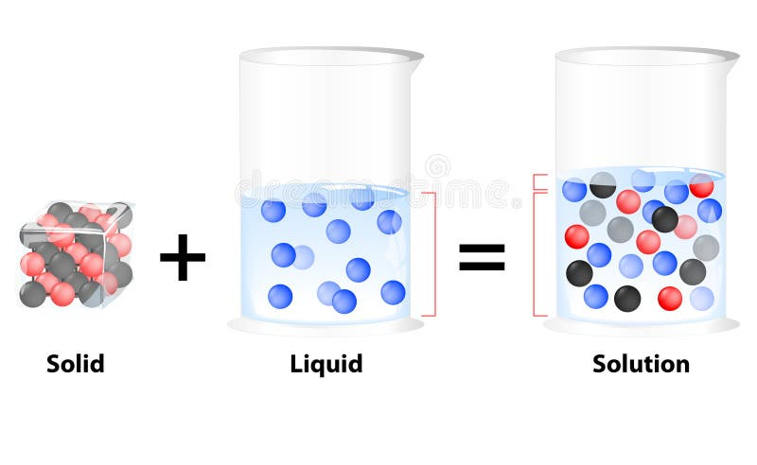
Notes:
Exposition type: Explanation
Suggested script:
You have all seen chemical equations before, for example (annotate on board) H₂ + 2O₂ -> 2H₂O. Now, we can add something to this equation to tell a bit more information about the different substances.
State symbols give more information about the state of reactants and products.
What do I mean by state? Whether the substances are solid, liquid or gas.
We write the state symbols as subscript (annotate on board to demonstrate this).
(s) indicates the substance is a solid.
(l) indicates the substance is a liquid.
(g) indicates the substance is a gas.
(aq) indicates the substance is aqueous. An aqueous solution forms when a substance dissolves in water.
State symbols are useful because they show what a substance is like. For example:
H₂O(l) is liquid water but H₂O(g) is steam
HCl(g) is hydrogen chloride gas but HCl(aq) is hydrochloric acid
Teacher subject knowledge: Are salts always represented as aqueous? No. (aq) is only when the salt is dissolved in water. (aq) represents an “aqueous” state where the ions which make up the salt are completely surrounded by water molecules (in solution). Salts commonly exist as solids, which would then be represented by (s). We can melt salts if we heat them up beyond their melting points to form the liquid state, which would then be represented by (l). And if sufficient heat is provided which exceeds the boiling point, it would send the salt into the gaseous state, which would then be represented by (g).

Slide 10
What does (g) mean?
solid
liquid
gas
dissolved
Notes:
Exposition type: Explanation
Suggested script:
You have all seen chemical equations before, for example (annotate on board) H₂ + 2O₂ -> 2H₂O. Now, we can add something to this equation to tell a bit more information about the different substances.
State symbols give more information about the state of reactants and products.
What do I mean by state? Whether the substances are solid, liquid or gas.
We write the state symbols as subscript (annotate on board to demonstrate this).
(s) indicates the substance is a solid.
(l) indicates the substance is a liquid.
(g) indicates the substance is a gas.
(aq) indicates the substance is aqueous. An aqueous solution forms when a substance dissolves in water.
State symbols are useful because they show what a substance is like. For example:
H₂O(l) is liquid water but H₂O(g) is steam
HCl(g) is hydrogen chloride gas but HCl(aq) is hydrochloric acid
Teacher subject knowledge: Are salts always represented as aqueous? No. (aq) is only when the salt is dissolved in water. (aq) represents an “aqueous” state where the ions which make up the salt are completely surrounded by water molecules (in solution). Salts commonly exist as solids, which would then be represented by (s). We can melt salts if we heat them up beyond their melting points to form the liquid state, which would then be represented by (l). And if sufficient heat is provided which exceeds the boiling point, it would send the salt into the gaseous state, which would then be represented by (g).

Slide 11
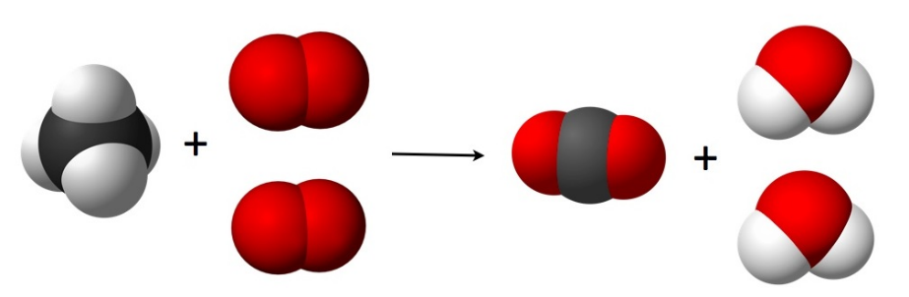
Conservation of Mass
The law of conservation of mass states that matter cannot be created or destroyed, only transferred from one form to another.
Mass before = mass after
Atoms are not created or destroyed
Atoms are only rearranged
Notes:
Exposition type: Explanation
Suggested script:
What is mass? Mass is how much stuff (or matter) there is.
What does the word conservation mean? To save or keep.
So, conservation of mass is about keeping mass, or saving mass. Show definition.
Mass is usually measured in kilograms (kg) or grams. There are 1000 grams in a kilogram. Different atoms have a different amounts of mass as you’ve seen in our previous two lessons.
Mass, including the mass of atoms, cannot be created or destroyed – just transformed from one form to another. We call this the law of conservation of mass. What do I mean by transformed?
In a reaction there will always be the same number of atoms on each side of the equation.
Look at this diagram. An even better approach would be to use molymods to demonstrate the rearranging of atoms here. The red atoms represent oxygen atoms. The reactants contain 1, 2, 3, 4 atoms of oxygen. Now let’s look at the products. They also contain 1, 2, 3, 4 atoms of oxygen, but they are rearranged. The oxygen atoms have been transformed from one type of substance to another, but the atoms themselves haven’t changed. There are still the exact same atoms in there, in the same amount.
The black particle in the diagram is carbon.
How many of these atoms can we see in the reactants? 1.
How many can we see in the products? 1
Again, the same number and type of atoms are there before the reaction and after. This is what we mean by conservation of mass – we are saving or conserving the mass.
The law of conservation of mass states that the total mass of the reactants equals the total mass of the products. That means that if you have a total mass of 200 kg of reactants then the total mass of the products will be 200 kg.
Image source: Wikimedia commons, public domain

Slide 12
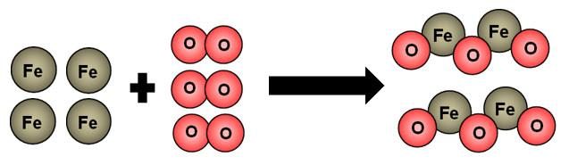
Does this diagram agree with the law of conservation of mass?
does
This diagram _________ agree with the law of conservation of mass because
What is the law of conservation of mass?
A. Atoms cannot be destroyed, just created
B. Atoms can be made from one form into another
C. Atoms cannot be created or destroyed, just changed from one form to another.
✓
Notes:
This diagram does agree with the law of conservation of mass, because the number of each type of atom is the same before and after the reaction. The total mass is conserved.
Stretch: If the mass of the products was 20g what would the mass of the reactants be? Explain why.

Slide 13
Fill in the blanks to show the meaning of the state symbols
State symbol | Meaning | Example
 |  | H₂
 | liquid
(s)
 |  | CuSO₄
(g)
gas
(l)
H₂O
solid
Mg
Aqueous (dissolved in water)
(aq)
Notes:
This activity has an accompanying worksheet for students.
On the worksheet, a selection of answers are given for pupils to choose from. For HA pupils, these suggestions can be removed to add challenge.
Here is a good opportunity to question pupils about the properties of each of the 3 states of matter they learned about C1.1. The residual knowledge they should be able to recall is:
• The three states of matter are solid, liquid and gas
• Solids have a fixed shape, cannot flow and cannot be compressed.
• Liquids are able to flow and take the shape of their container and cannot be compressed
• Gases can flow and completely fill their container and can be compressed

Slide 14


True or false?
During a chemical reaction the atoms are rearranged.
The mass of an ice cube decreases when it melts.
2Al_{(s)} + 3Cl_{2 (g)} → 2AlCl₃ _{(s)} is a balanced equation.
Gases have no mass.
Mass is always conserved in chemical reactions.
True False
True
False
True
False
True
Notes:
Purpose: to check that key knowledge from the introduce phase has been learnt and understood.
1T; 2F; 3T; 4F; 5T;

Slide 15
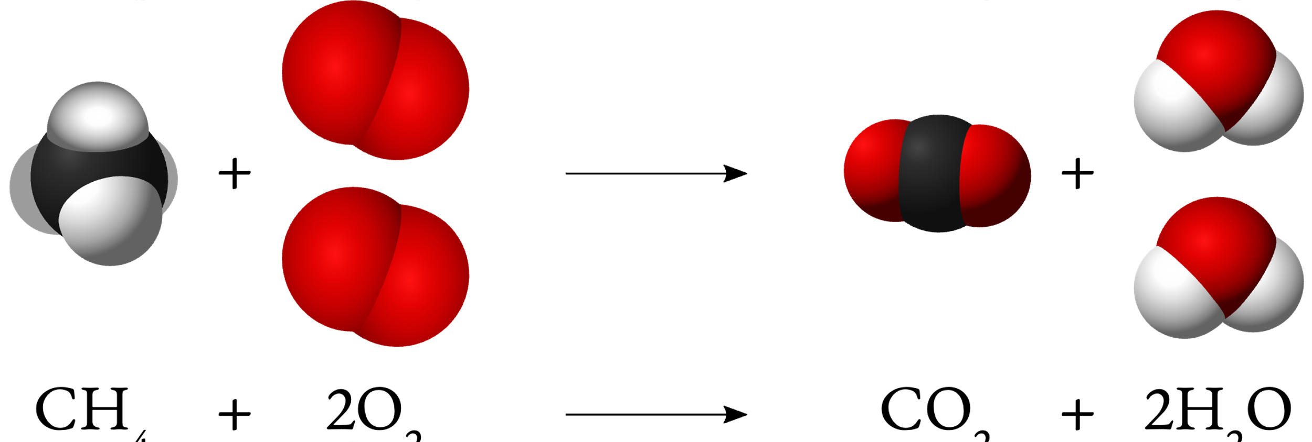
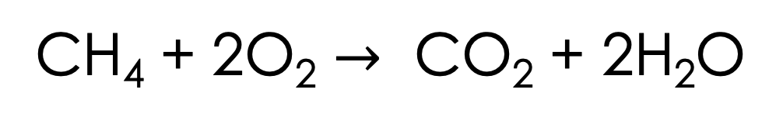
What is being shown in this image?
CH₄ + 2O₂ $→$ CO₂ + 2H₂O
Words to use: conservation, atoms, molecule, two, reactants, products
Notes:
Questions to ask students as they are discussing this image:
What does each part of the diagram represent? What are the white parts/red parts/black parts?
Does this diagram show conservation of mass?
2 of the reactants are gases, and 1 of the products is a liquid. Does that mean the products will be heavier than the reactants?
Suggested guidance:
Talk tasks can be used in a variety of ways to suit the particular needs of the students you are teaching. Through exchanging views with others, students develop their understanding of the science beyond what could be achieved individually.
Science classrooms that successfully integrate talk have the following features:
Science talk is a regular feature of lessons and is woven into classroom activities.
Students are paired or grouped strategically by the teacher to ensure productive interaction. This might take into consideration the students’ proficiency of the English language, how encouraging they might be to peers and their attainment in the topic. It’s a good idea to consider these pairings in the class seating plan.
Students are encouraged and supported to talk but are not forced to talk.
The teacher should take on the role of a facilitator, engaging with conversations where necessary and encouraging or steering the conversation where needed.
Students are encouraged to use the language they have to express their ideas (e.g., everyday language, imperfect English, native language), but also to incorporate science specific terminology where this is more accurate or has been taught.
6. Scientifically inaccurate ideas are not dismissed by the partner or teacher; open discussion and further investigation are relied on to help students construct ideas that support them to progress in their scientific understanding.
7. Guidelines for behaviour during talk tasks are explicit and frequently reviewed. Rules for students might be:
Listen carefully to your partner
Take turns talking.
Speak one at a time, without interrupting.
Politely agree or disagree and explain why.
Politely point out if your partner has used a scientific word incorrectly, if they have explained the science incorrectly, or if there is a more accurate way to describe something.
If confused, ask questions.
Stay focused on the discussion topic.
Respond to one another.
Image source: Methane-combustion.svg Source: Wikimedia Commons. Author: Yulo1985 This file is licensed under the Creative Commons Attribution-Share Alike 4.0 International license.

Slide 16
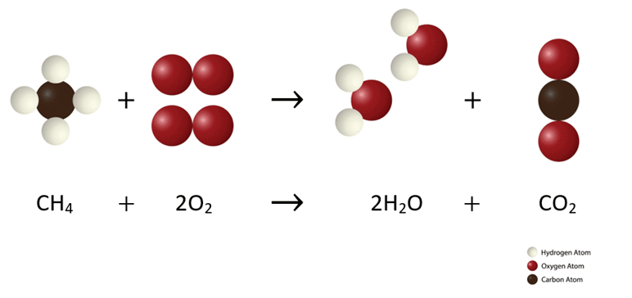
Conservation of Mass
Atoms are not created or destroyed in a chemical reaction. They are only rearranged.
Notes:
Questions to ask students as they are discussing this image:
What does each part of the diagram represent? What are the white parts/red parts/black parts?
Does this diagram show conservation of mass?
2 of the reactants are gases, and 1 of the products is a liquid. Does that mean the products will be heavier than the reactants?
Suggested guidance:
Talk tasks can be used in a variety of ways to suit the particular needs of the students you are teaching. Through exchanging views with others, students develop their understanding of the science beyond what could be achieved individually.
Science classrooms that successfully integrate talk have the following features:
Science talk is a regular feature of lessons and is woven into classroom activities.
Students are paired or grouped strategically by the teacher to ensure productive interaction. This might take into consideration the students’ proficiency of the English language, how encouraging they might be to peers and their attainment in the topic. It’s a good idea to consider these pairings in the class seating plan.
Students are encouraged and supported to talk but are not forced to talk.
The teacher should take on the role of a facilitator, engaging with conversations where necessary and encouraging or steering the conversation where needed.
Students are encouraged to use the language they have to express their ideas (e.g., everyday language, imperfect English, native language), but also to incorporate science specific terminology where this is more accurate or has been taught.
6. Scientifically inaccurate ideas are not dismissed by the partner or teacher; open discussion and further investigation are relied on to help students construct ideas that support them to progress in their scientific understanding.
7. Guidelines for behaviour during talk tasks are explicit and frequently reviewed. Rules for students might be:
Listen carefully to your partner
Take turns talking.
Speak one at a time, without interrupting.
Politely agree or disagree and explain why.
Politely point out if your partner has used a scientific word incorrectly, if they have explained the science incorrectly, or if there is a more accurate way to describe something.
If confused, ask questions.
Stay focused on the discussion topic.
Respond to one another.
Image source: Methane-combustion.svg Source: Wikimedia Commons. Author: Yulo1985 This file is licensed under the Creative Commons Attribution-Share Alike 4.0 International license.

Slide 17
Drill
What is the state symbol for gas?
What is the state symbol for liquid?
What is the state symbol for solid?
What is the state symbol for aqueous?
What does aqueous mean?
Where must you position the state symbol when writing chemical formulae?
What is the law of conservation of mass?
If I use 400 g of cake ingredients, mix them and they then undergo a chemical reaction in the oven, what will the mass of the cake be?
If 100 g of CaCO₃ is heated in the chemical reaction below, 66 g of CaO is produced. What mass of CO₂ will be produced?
If the same reaction was done on a mass balance, it would show 66 g. Why?
CaCO_{3(s))} → CaO_{(s)} + CO_{2(g)}
Notes:
Purpose: This is a knowledge drill. The purpose of this is to check that the critical knowledge is secure before pupils move onto independent practice.
Suggested guidance: There are a range of ways this could be done depending on time and ability range of the class:
Mini whiteboards
As full sentences in exercise books
As short answers in exercise books
In the pupil workbook
As pair talk
As cold call

Slide 18
Drill answers
(g)
(l)
(s)
(aq)
Dissolved in water
Subscript, after the chemical formula
Matter cannot be created nor destroyed, only transformed from one to another
400g
44g
CO₂ is a gas and it escaped from the container
Notes:
Purpose: This is a knowledge drill. The purpose of this is to check that the critical knowledge is secure before pupils move onto independent practice.
Suggested guidance: There are a range of ways this could be done depending on time and ability range of the class:
Mini whiteboards
As full sentences in exercise books
As short answers in exercise books
In the pupil workbook
As pair talk
As cold call

Slide 19
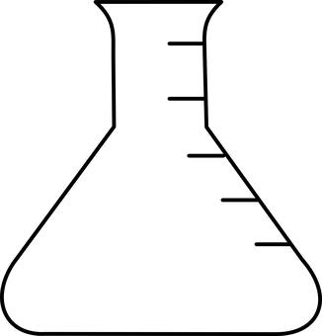
I: Conservation of mass
56g of calcium oxide reacts with 73g of hydrochloric acid.
What is the word equation for this reaction?
The formula for calcium chloride is CaCl₂. What is the balanced symbol equation for this reaction? Include state symbols
What are the relative formula masses for each reactant and product? Write these below the symbol equation.
Now write the mass for each substance below the symbol equation
Calcium oxide + hydrochloric acid → calcium chloride + water
CaO_{(s)} + 2HCl_{(aq)} → CaCl_{2(aq)} + H₂O_{(l)}
56 36.5 111 18
56 73 111 18
Notes:
To make this simpler for students the example is using 20g of an acid. If any student queries the reasoning behind it you can say that the density of the acid is 1g/cm³ so we have converted the volume into grams in order for us to understand this as conservation of mass.
You can also tell students that they will cover density in year 10 and will see this knowledge applied then.
For question 2 and 3, please stress in your exposition that due to HCl having a coefficient of 2 the relative formula mass has doubled to give its mass. Please also stress that the mass of the reactants = mass of the products.

Slide 20
We: Conservation of mass
4.8g of Magnesium reacts with oxygen, producing 8g of Magnesium oxide (MgO).
What is the word equation for this reaction?
What is the balanced symbol equation for this reaction? Include state symbols
What are the relative formula masses for each reactant and product? Write these below the symbol equation.
Now write the mass for each substance below the symbol equation
Why is the mass of oxygen 3.2 g?
Magnesium + oxygen → Magnesium oxide
2 Mg_{(s)} + O_{2(g)} → 2MgO_{(s)}
24 32 40
4.8 3.2 8.0
The mass of the reactants = Mass of the products. 4.8 + 3.2= 8.0
Notes:
For question 2 and 3, please stress in your exposition that the masses for Mg and MgO are 5 times smaller due to a coefficient of 2 but oxygen is 10 times smaller is not due to ratios but because the law of conservation of mass mean 8-4.8=3.2 . Please also stress that the mass of the reactants = mass of the products.

Slide 21
You: Conservation of mass There is a gas involved in the reaction below, which apparatus can prove the law of conservation of mass? Explain your answer.
Cotton wool
Rubber bung
A
B
B is better because the bung will prevent any gases from escaping and so you can find the mass of them. The cotton wool will allow gases to escape because the gas particles are so small they can make their way through the cotton wool.

Slide 22
Answer the questions below.
If 3 g of copper oxide and 2 g of carbon dioxide were produced, how many grams of copper carbonate was broken down? CuCO_{3(s)} → CuO_{(s)} + CO_{2(g)}
A. 1 g
B. 6 g
C. 5 g
When copper carbonate is heated, the mass recorded on a balance decreases. Which of the following is false?
A. The loss in mass is due to a change in state.
B. The loss in mass is due to a formation of gas.
C. The mass of products equals the mass of reactants.
Which of the following is correctly balanced?
A. 2P + 5O₂ → 2P₂O₅
B. 2P + 5O₂ → P₂O₅
C. 4P + 5O₂ → 2P₂O₅
✓
✓
✓
Notes:
Q1. Answer: C
If students answer A, they have (incorrectly) taken the mass of carbon dioxide away from the mass of copper oxide, which indicates that they have not grasped how the total mass of the reactants should be equal to the total mass of the products, and therefore do not yet understanding the law of conservation of mass as it relates to the mass of substances in an equation. If student answer B, they have multiplied he two values together, showing a similar misunderstanding of the relevance of the masses of reactants and products. To fix-it, use molymods to explain what we mean by conservation of mass in a chemical reaction. Build molecules using molymods to represent the three substances in this question to demonstrate for students how the mass before and after the reaction should be the same. Ask students to complete similar questions, where the mass of some substances in a chemical reaction is provided, and students should use the law of conservation of mass to deduce the unknown mass.
Q2. Answer: A
If students answer B or C, students may have the misconception that a change in state is a chemical reaction, and that this might result in a change in mass. To fix-it, describe the difference between a chemical and physical change, and link this back to conservation of mass.
Q3. Answer: C
If students answer A or B, they are unable to recognise a balanced equation, or may be confused about the notation used: subscript and coefficients. To fix-it, give students a list of chemical equations, and ask them to list the elements represented and the number of atoms for each one.

